Slide 1
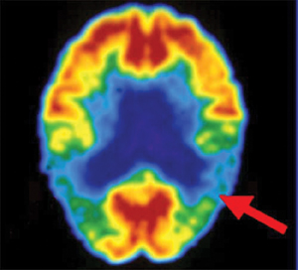
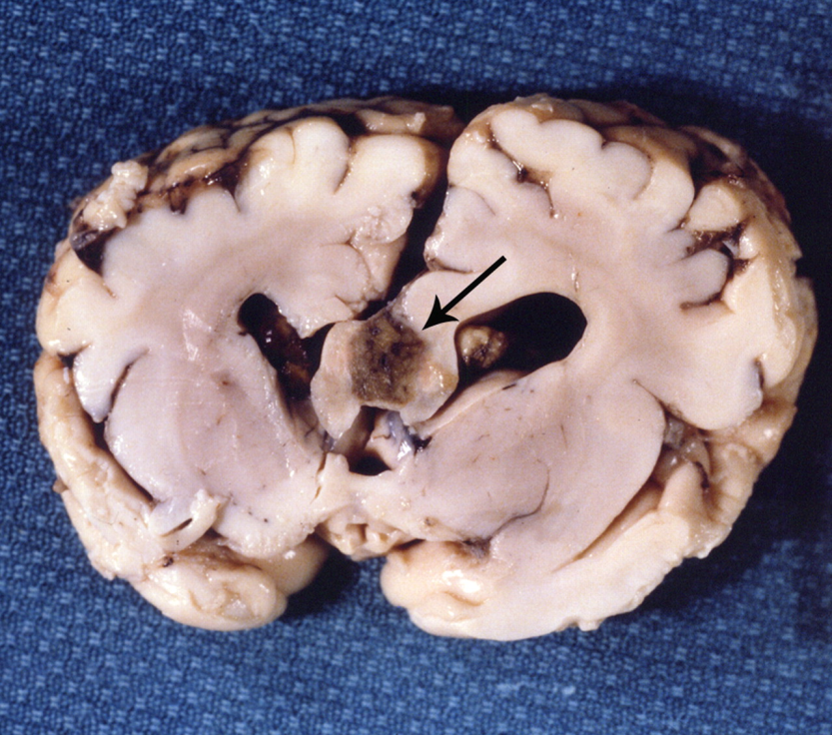
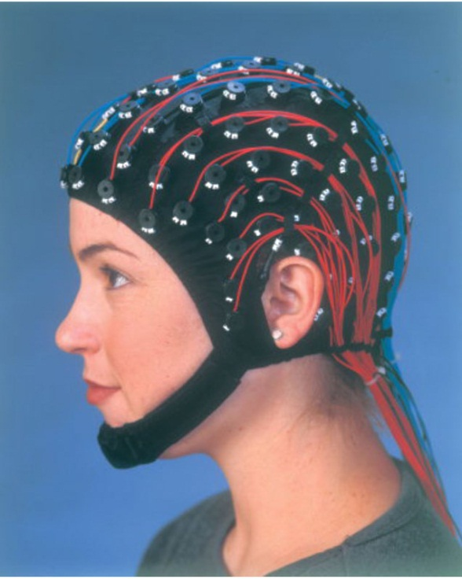
Neurological Disorders Lesson 1.3
How can we study the behaving brain?

Slide 2
Do Now
Review last night’s homework with a partner.

Slide 3
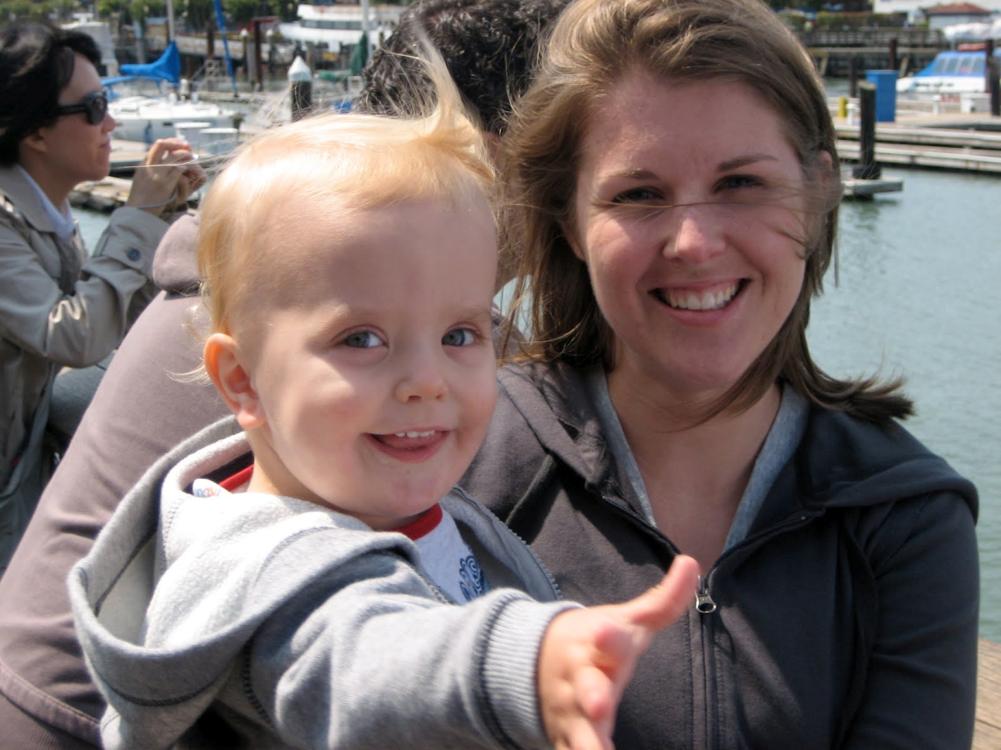
Case Study: Jesse
Jesse arrives at the clinic, he is 14 months old
Though he looks normal in many respects, his parents are worried about him

Slide 4
Developmental Milestones by End of 1st Year
Reaches sitting position without assistance.
Crawls forward on belly.
Finds hidden objects easily.
Looks at correct picture when the image is named.
Uses gestures, such as waving or shaking head.
Repeats sounds or gestures for attention.
Says single words (“mama” or “dada”).
Responds to simple verbal requests.

Slide 5
Developmental Milestones by End of 1st Year
Reaches sitting position without assistance.
Crawls forward on belly.
Finds hidden objects easily.
Looks at correct picture when the image is named.
Uses gestures, such as waving or shaking head.
Repeats sounds or gestures for attention.
Says single words (“mama” or “dada”).
Responds to simple verbal requests.

Slide 6
Jesse comes back to the clinic.
His developmental delays have not resolved and he is now displaying certain attention deficit behaviors that sometimes become self-destructive.
What would you do after testing these behaviors?

Slide 7
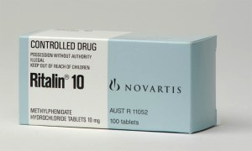
Attention Deficit Disorder Drugs
Ritalin is a mild central nervous system stimulant.
It affects chemicals in the brain that contribute to hyperactivity and impulse control.

Slide 8
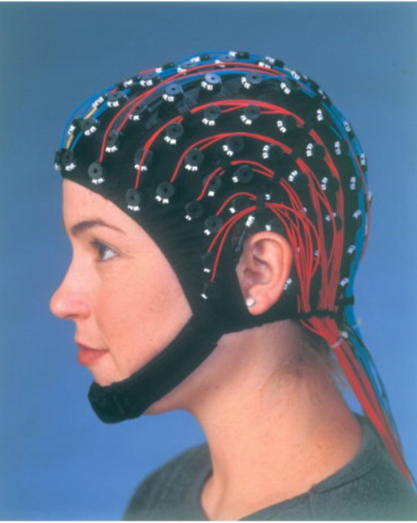
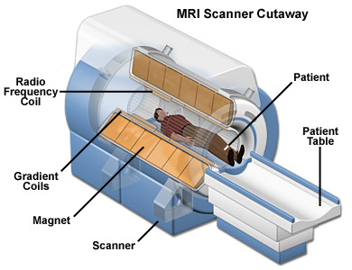
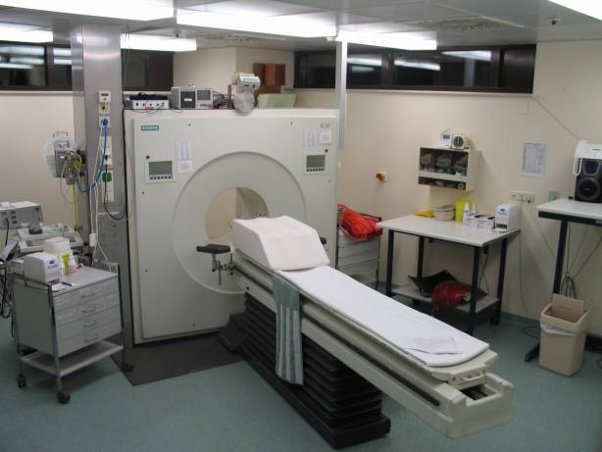
Activity: Tests to Diagnose Jesse
PET Scan
MRI
EEG

Slide 9
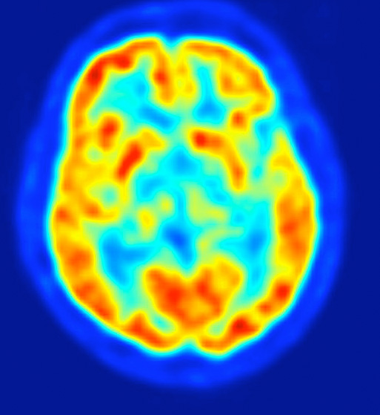
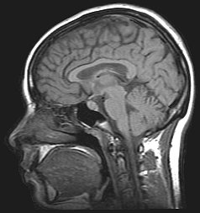
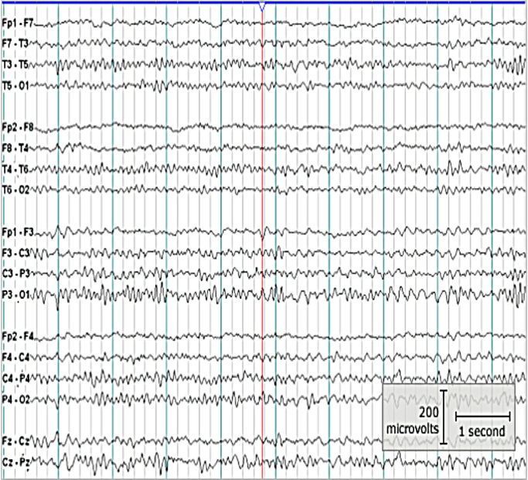
What test would you order for Jesse?
PET Scan
MRI
EEG

Slide 10
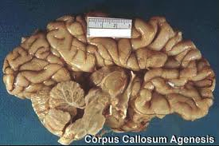
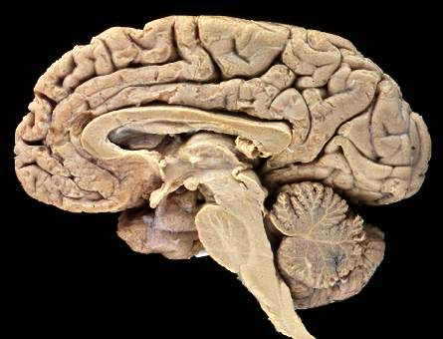
A horrible accident…
Sagittal section
Jesse’s brain at autopsy
Normal brain

Slide 11
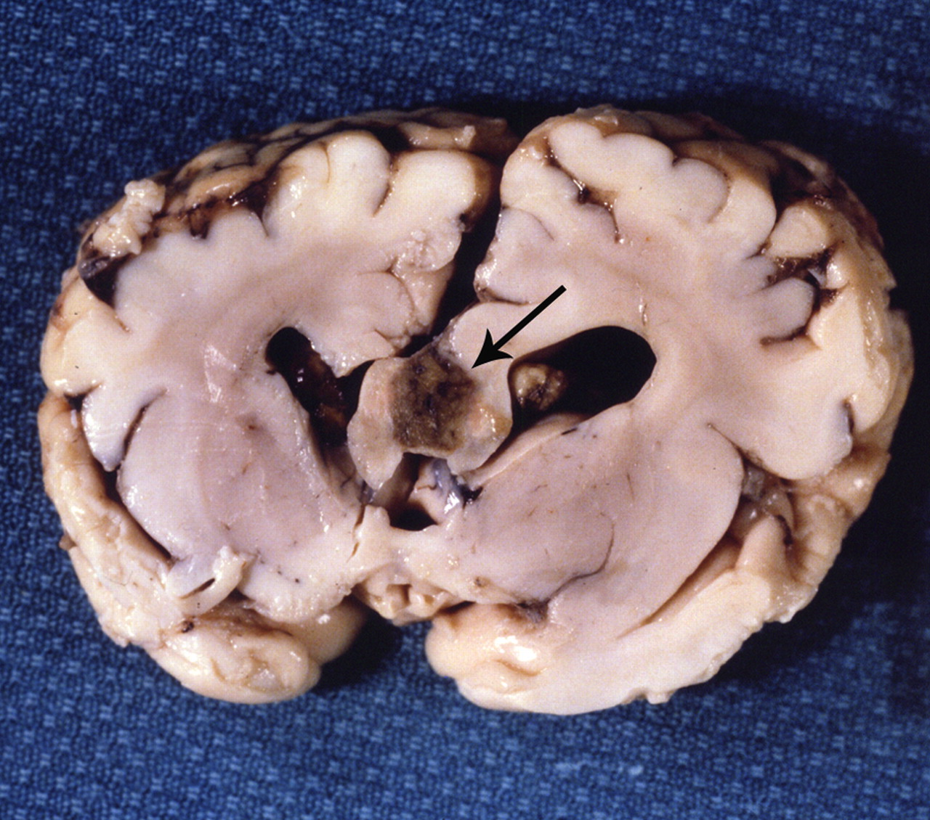
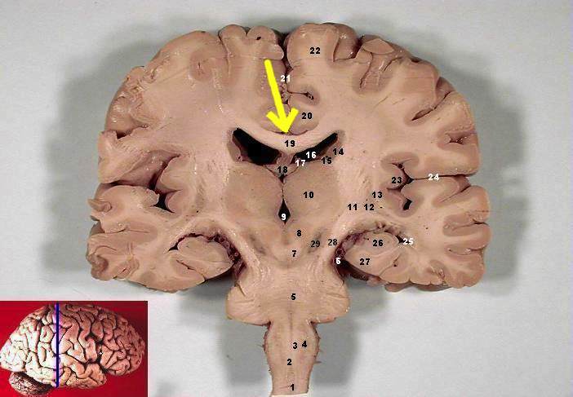
Agenesis of the Corpus Callosum
Coronal section
Jesse’s brain at autopsy
Normal brain

Slide 12
PET, MRI and EEG Additional Slides

Slide 13
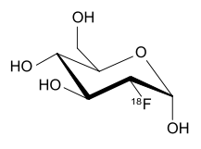
Positron Emission Tomography (PET)
¹⁸Fluorodeoxyglucose
Half life = 110 minutes
PET scanner

Slide 14
Positron Emission Tomography (PET)
Horizontal sections
Normal brain
Area of abnormal activity (seizure)

Slide 15
Positron Emission Tomography (PET)
Horizontal sections
Normal brain
Area of abnormal activity in Alzheimer’s patient

Slide 16
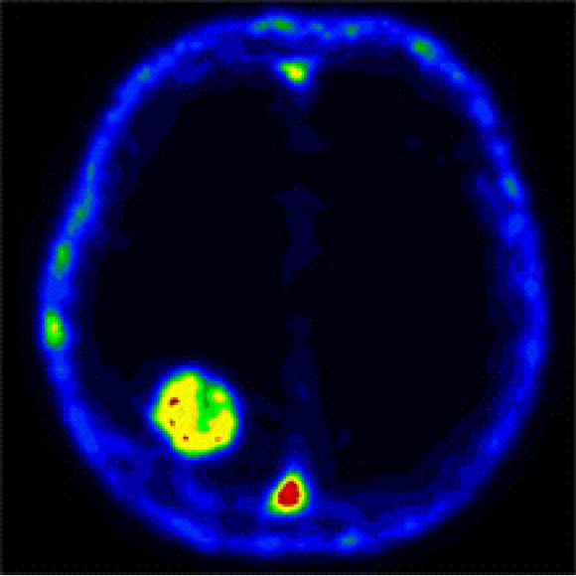
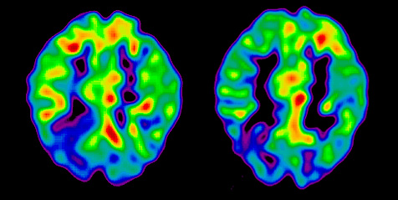
Positron Emission Tomography (PET)
Horizontal sections
Area of abnormal
activity (seizure)
Brain showing tumor

Slide 17
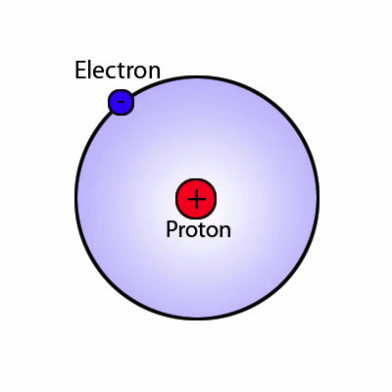
Magnetic Resonance Imaging (MRI)
Hydrogen atom
MRI scanner

Slide 18
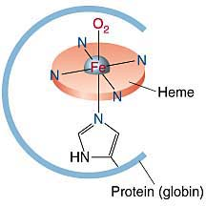
Functional Magnetic Resonance Imaging (fMRI)
Hemoglobin: Oxygenation changes Fe 2+ to Fe 3+
MRI scanner

Slide 19
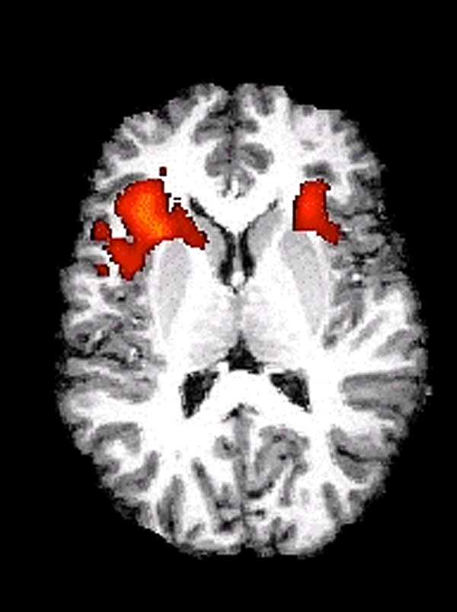
Magnetic Resonance Imaging (MRI)
Corpus callosum
Structural MRI
Functional MRI
(Subject read one word)

Slide 20
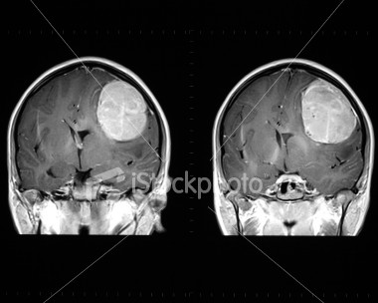
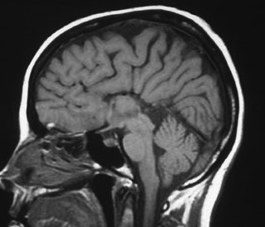
Magnetic Resonance Imaging (MRI)
Tumor
Agenesis of the corpus callosum

Slide 21
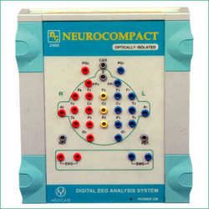
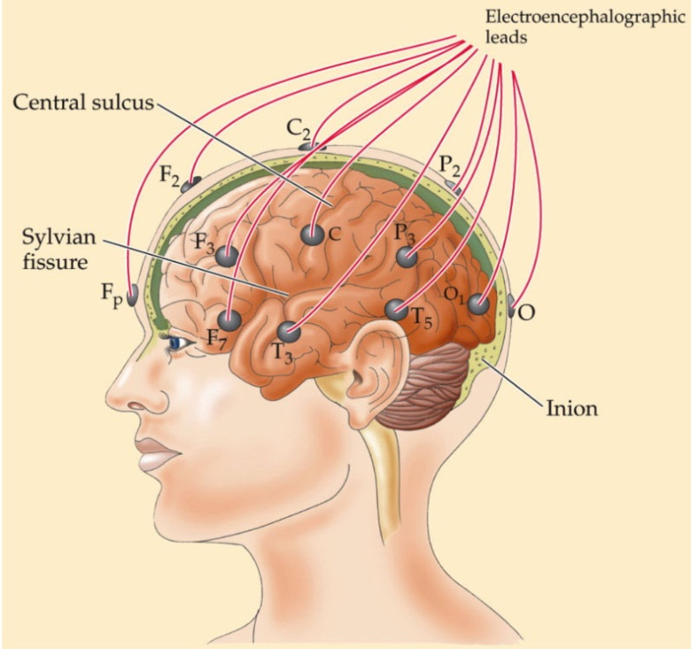
Electroencephalopathy (EEG)
Amplifier
Cap
Leads

Slide 22
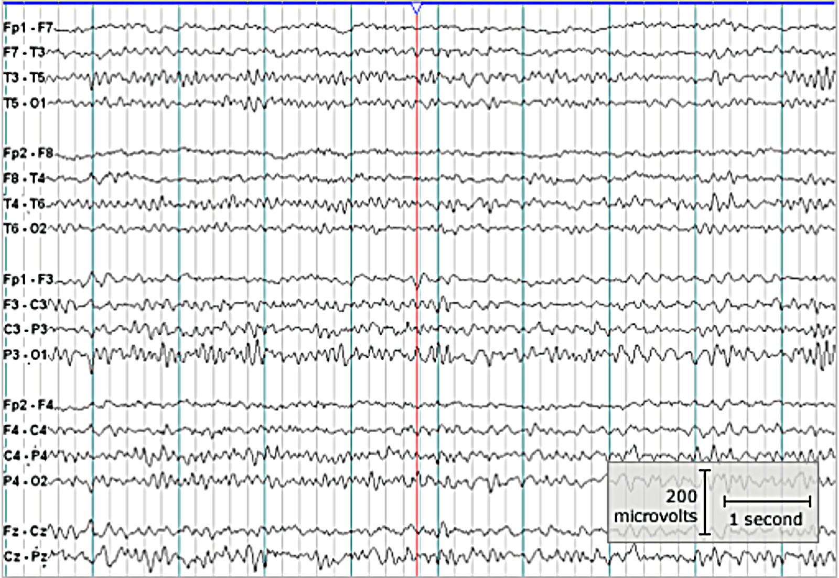
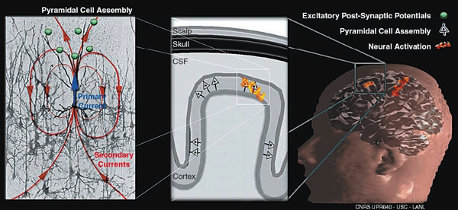
Electroencephalopathy (EEG)
Neurons responsible
for the signal
Parietal area between
electrodes

